Slide 1
Devadharshni M 711721244012 III B.Tech CSBS KGiSL Institute of Technology
CAPSTONE PROJECT
FRAUD DETECTION USING ANN
Final Project
Presented By
3/21/2024 Annual Review

Slide 2
PROJECT TITLE
Fraud detection in financial data by using Artificial Neural Network
3/21/2024 Annual Review

Slide 3


AGENDA
1. Problem Statement
2. Project Overview
3. End Users
4. Solution and Value Proposition
5. The Wow Factor in Your Solution
6. Modelling
7. Results
3/21/2024 Annual Review

Slide 4

PROBLEM STATEMENT
Financial fraud is a major issue for corporations and institutions, resulting in large financial losses and brand damage.
Using historical financial transaction data, we'll use Python's artificial neural network (ANN) to create a predictive model. The dataset will be used to train and test the model's ability to identify fraudulent transactions properly.
Detecting fraudulent activities in financial data is critical for ensuring transaction integrity and preserving stakeholders' interests.
3/21/2024 Annual Review

Slide 5

PROJECT OVERVIEW
The goal of this project is to create a comprehensive system for detecting fraud inside financial data.
The goal of using advanced data analytics and machine learning techniques is to uncover patterns and anomalies that indicate fraudulent behaviour, allowing for preemptive intervention and mitigation.
3/21/2024 Annual Review

Slide 6

WHO ARE THE END USERS?
This fraud detection system's end customers could include financial organisations including banks, credit card firms, and online payment platforms. These institutions are often responsible for detecting and preventing fraudulent actions within their systems in order to protect their clients and retain trust in their services.
Furthermore, regulatory and law enforcement authorities may employ such systems to monitor and investigate suspected financial activities.
3/21/2024 Annual Review

Slide 7

YOUR SOLUTION AND ITS VALUE PROPOSITION
Our solution employs a multi-faceted approach to fraud detection, incorporating data preprocessing, feature engineering, and machine learning algorithms.
The value proposition of our solution lies in its ability to enhance the overall security and integrity of financial transactions, thereby safeguarding stakeholders' interests and minimizing potential losses due to fraudulent activities
By analyzing historical transaction data and identifying patterns associated with fraudulent activities, the system can flag suspicious transactions in real-time, enabling timely intervention and prevention of fraudulent behavior.
By deploying our system, organizations can mitigate risks, streamline operations, and maintain trust with their customers and partners.
3/21/2024 Annual Review

Slide 8

THE WOW IN YOUR SOLUTION
One of the key distinguishing features of our solution is its adaptability and scalability. By leveraging cutting-edge machine learning algorithms and continuously learning from new data, the system can evolve and adapt to emerging fraud patterns and tactics.
Its machine learning capabilities enable continuous evolution to combat emerging fraud tactics, ensuring ongoing protection.
Furthermore, our solution offers a user-friendly interface and seamless integration with existing financial systems, making it accessible and easy to deploy across various organizations and industries.
3/21/2024 Annual Review
8

Slide 9
MODELLING
The modeling phase involves data preprocessing, feature selection, and the implementation of machine learning algorithms such as supervised learning classifier
The models are trained on labeled datasets containing both genuine and fraudulent transactions, allowing them to learn patterns indicative of fraudulent behavior.
Evaluating model performance using a separate test dataset, calculating metrics like accuracy.
3/21/2024 Annual Review
9

Slide 10
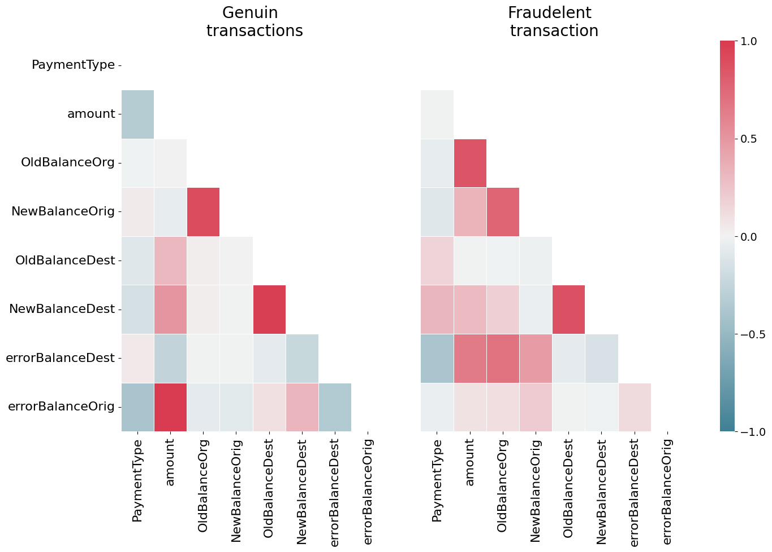
RESULTS
bit.ly/4aOIlnh
3/21/2024 Annual Review
10

